Slide 1
Micro Web Frameworks
Open Source + .NET

Slide 2
Definition
Lean - provides only the bare essentials for serving web applications on the web
Simple setup - getting web pages up and running should not require a lot of infrastructure code
Extensible API - enhanced features should be provided by other libraries that extend the framework
"Close to the metal"

Slide 3


Ruby micro web framework
$ gem install sinatra
$ ruby –rubygems app.rb
require 'sinatra'
require 'liquid'
get '/' do
liquid :index
end

Slide 4
Traditional web frameworks
Micro web frameworks
WebForms
ASP.NET MVC
FubuMVC
OpenRasta
Nancy
Jessica
Tinyweb
Nina
Martin
NSinatra

Slide 5
Nancy
#nancyfx
nancyfx.org
http://goo.gl/ZDRZ7

Slide 6
Setting up a project
Add Nancy assembly references
Set up web.config
Create folders for modules, views, assets
Add modules with routes
Add views and assets

Slide 7
Components
HTTP handler
Modules
Routes
Views
Response
View engines
Bootstrapping (IoC)
Hosting
Caching
Authentication

Slide 8
Modules
All modules inherit from NancyModule.
Modules support standard HTTP methods:
NancyModule.Get[]
NancyModule.Put[]
NancyModule.Post[]
NancyModule.Delete[]
NancyModule.Head[]

Slide 9
Routes
Routes are attached to HTTP methods in Module constructors.
Routes have several elements
method
pattern (path)
action
(optional) condition

Slide 10
Route patterns
A Route pattern is matched against the URL to determine which route's action to execute. A path may be:
a literal path: /home/about
segments matched by regular expression back-references: /product/(?<id>[\d]+)/info
variable segments: /product/{id}/info

Slide 11
Route patterns
A root path for all module routes may be assigned by passing a single string to the NancyModule base constructor.
public class MyModule : NancyModule {
public MyModule() : base("/home") {
//matches /home/faq
Get["/faq"] => p => {
return View["faq.html"];
};
}
}

Slide 12
Route actions
The action receives a dynamic "parameters" argument, and returns a Nancy.Response object. It is typically constructed as a lambda in the Module route definition.

Slide 13
Route anatomy
Get[“/shop/books”] = x => { return View[“books.html”];
};
method
pattern
action

Slide 14
Route resolver
Routes are resolved by a series of "filtering" rules:
determine if any routes are a match for the requested path
determine if any matching path routes are applicable for the given request method
determine which routes have the most parameter captures, and choose the first

Slide 15
Route resolver
Once a route is resolved, a few things happen:
if the route's module has a "Before" pipeline defined, it will be executed
the route's action is invoked with a dictionary of dynamic parameters (from the request)
if the route's module has an "After" pipeline defined, it will be executed

Slide 16
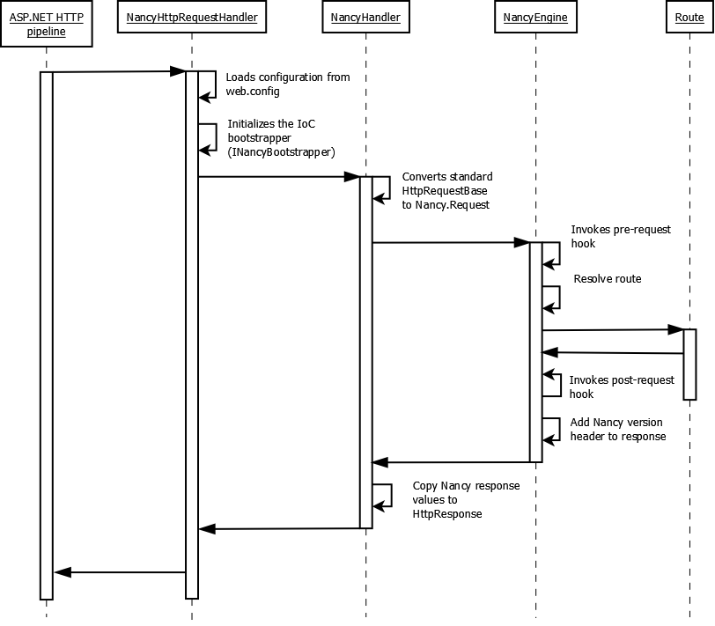

Slide 17
Serving up views
Views are files that may or may not be parsed by a view engine.
standard HTML files
Razor templates
Spark templates
DJango templates

Slide 18
Serving up views
View engines are selected dynamically, based on the view's file extension.
By convention, views must all be located in a ~/views folder in the web application (this will change in the future).

Slide 19
Serving up views
Currently, layout management (e.g., master pages) and partials are unsupported, because those features are implemented in the ASP.NET and MVC assemblies, respectively.
The exception to this is the Spark view engine, which uses its own content inclusion scheme.

Slide 20
View engines
All view engines derive from IViewEngine, and may support one or more file extensions.
When a view is rendered, the appropriate view engine is selected based on the view file extension.

Slide 21
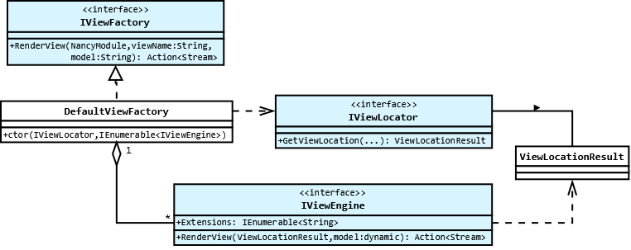

Slide 22
View engines
Custom view engines may be created by creating a class that implements IViewEngine.
Nancy comes pre-packaged with several different view engines:
NDjango
Razor
Spark

Slide 23
Response
The Nancy.Response object is responsible for aggregating cookies, headers, an HTTP status code, and an Action<Stream> delegate that returns rendered output to the HttpResponse object.
Route actions return a Nancy.Response object.

Slide 24
Response
The Nancy.Response object has a number of helpful implicit cast operators:
HttpStatusCode enumeration
Int32 (status code value)
String (contents)
Action<Stream> (response stream delegate)

Slide 25
Specialized responses
The Nancy.Response object provides specialized extension methods for returning content other than views.
AsFile()
AsCss()
AsImage()
AsJs()
AsRedirect()
AsXml()

Slide 26
Specialized responses
These methods return specialized subclasses of the Nancy.Response object that are each responsible for locating, formatting, and setting response headers for the data that is streamed back to the client.

Slide 27
Static content
An alternative to serving static files is to place a special web.config file in directories that contain static content, and then reference the content using normal URL paths.
<?xml version="1.0"?> <configuration> <system.web> <httpHandlers> <remove verb="*" path="*"/> </httpHandlers> </system.web> <system.webServer> <handlers> <remove name="Nancy" /> </handlers> </system.webServer> </configuration>

Slide 28
View models
By default, Nancy uses dynamic objects for view models, which makes it very simple to pass data into a view.
Custom types are supported as well, and may be passed to a view just like a dynamic object.

Slide 29
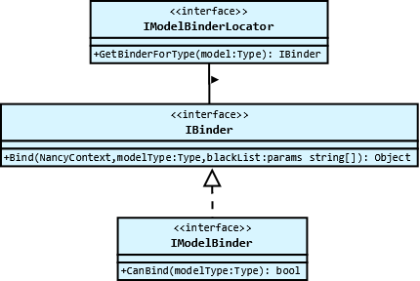
Model binders
Nancy uses a DefaultBinder to convert data from the HTTP context to model types.

Slide 30
Model binders
If a view model requires special treatment during the request lifecycle, a specialized model binder may be created by implementing the IModelBinder interface, and overwriting the CanBind() and Bind() methods.

Slide 31
Bootstrapping (IoC)
Nancy makes use of IoC containers to bootstrap the framework.
The type responsible for bootstrapping must be declared in the <nancyFx /> configuration section.

Slide 32
Bootstrapping (IoC)
Custom bootstrappers only technically need to implement INancyBootstrapper, but the NancyBootstrapperBase<T> class provides many helper methods for using default Nancy types, and loading types from custom assemblies.

Slide 33
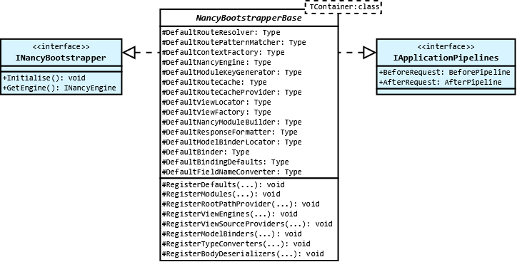

Slide 34
Bootstrapping (IoC)
The DefaultNancyBootstrapper type uses TinyIOC, and is the default out-of-the-box container, however Nancy also includes boostrappers for:
Ninject
StructureMap
Unity
Windsor

Slide 35
Hosting
Nancy can be hosted in several types of environments.
ASP.NET
WCF
Self-hosted
Owin - “a standard interface between .NET web servers and web applications [that] decouple[s] server and application and, by being an open standard, stimulate the open source ecosystem of .NET web development tools.”

Slide 36
Caching
Caching in Nancy is achieved by attaching to the “BeforeRequest” and “AfterRequest” pipelines of a custom bootstrapper object.
When the Nancy engine receives a request, it will execute event handlers attached to these pipelines.

Slide 37
Authentication
Authentication is performed on a per-module basis. Routes that correspond to logging in/logging out should be un-secured.

Slide 38

#jessicafx
Jessicafx.org
github.com/tombell/jessica

Slide 39
“Nancy has taken an approach to making many parts of the framework replaceable; if you don’t like the functionality of X you can create your own… I would like Jessica to become a feature equivalent of Sinatra for .NET, without heading in a similar direction that Nancy has taken. Jessica should have simple configuration, simple conventions, and simple code.” – Tom Bell

Slide 40
Setting up a project
Add Jessica assembly references
Create Global.asax and web.config
Create folders for modules, views, and assets
Create modules with routes and actions
Add views
Add assets

Slide 41
Setting up a project
Minimum web.config
<?xml version="1.0"?>
<configuration>
<system.web>
<compilation debug="true"/>
</system.web>
</configuration>

Slide 42
Setting up a project
Global.asax:
protected void Application_Start(object sender, EventArgs e)
{
Jess.Initialise();
}

Slide 43
Components
HttpHandler
Modules
Routes
Views
Response
View engines
Factory (IoC)

Slide 44
Modules
All modules inherit from JessModule.
Modules support standard HTTP methods:
JessModule.Get()
JessModule.Post()
JessModule.Put()
JessModule.Delete()

Slide 45
Routes
Routes are passed to class methods that correspond to HTTP methods in the module constructor.
Rotes are composed of:
a route pattern
an action

Slide 46
Route patterns
A Route pattern is used to match a URL to a route handler. Patterns may be:
a literal path: /shop/books
variable segments: /shop/books/:id

Slide 47
Route patterns
Root paths may also be used in Jessica, by passing the root path to the JessModule base constructor.
public class MyModule : JessModule {
public MyModule() : base("/home") {
//matches /home/faq
Get("/faq", p => View("faq"));
}
}

Slide 48
Route actions
Jessica routes receive dymanic objects which contain route parameters, and return a Jessica.Response object. Actions are typically lambda expressions defined when the route is added in the Module constructor.

Slide 49
Route anatomy
Get("/shop/books/:id",
p => View("books", p));
method
pattern
action

Slide 50
Route resolution
Jessica makes use of the default ASP.NET routing engine. When Jess.Initialise() is called in Global.asax, routes are added to the .NET RoutingTable class.

Slide 51
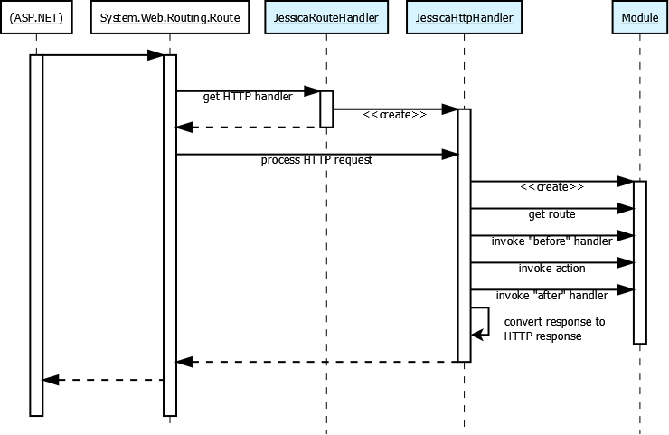

Slide 52
Serving up views
Views are flat files that may or may not be parsed by a view engine.
By convention, views must be placed in the ~/Views folder. Presently, this is not extensible, but that may change in the future.

Slide 53
Serving up views
View engines are selected dynamically, based on the view’s file extension. Views are resolved, however, with the base file name.
Master pages and partials are currently unsupported in Jessica (for the same reason as Nancy, and with the same exception of the Spark view engine).

Slide 54
View engines
View engines implement the IViewEngine interface, and may support one or more file extensions.
View engines are selected by the ViewFactory based on the file extension of the view being rendered.

Slide 55
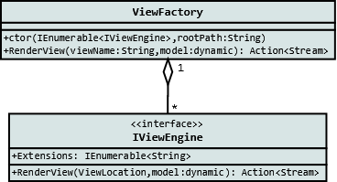

Slide 56
View engines
Custom view engines can be added by creating a class that implements IViewEngine.
Jessica has no out-of-the-box view engine implementation. To use a view engine, an appropriate view engine library must be referenced.

Slide 57
View engines
Authored by Tom Bell
Razor
Spark
DotLiquid
Authored by me
Markdown
Textile

Slide 58
Response
Actions must return an instance of Response. Jessica has several standard responses:
TextResponse
RedirectResponse
FileResponse
JsonResponse
StaticFileResponse

Slide 59
Response
The Jessica Response object behaves like the Nancy response object.
Both have implicit operators to cast things like HTTP response codes to an actual Response object.
Both have helper methods like AsCss(), AsJs(), AsRedirect(), etc. to render specific types of content.

Slide 60
View models
All view models in Jessica are dynamic objects. Strong types may be used, but there is no special model binding provision for special cases at this time.

Slide 61
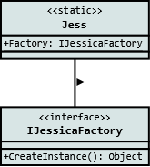
Factories (IoC)
Modules and view engines are created by a default implementation of IJessicaFactory.
This interface may be extended to implement a factory that uses any popular IoC container.

Slide 62
Factories (IoC)
There are presently two Factory IoC implementations available for Jessica:
Ninject
StructureMap

Slide 63
Factories (IoC)
To change the factory that Jessica uses to resolve types, simply assign a new instance of a custom factory to Jess.Factory before calling Initialise() in Global.asax.
Jess.Factory = new MyCustomFactory();
Jess.Initialise();

Slide 64
<<code>>

